Slide 1
Video 6: Convexity

Slide 2
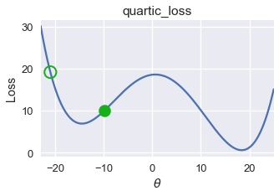
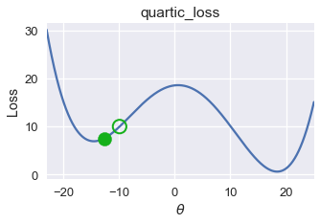
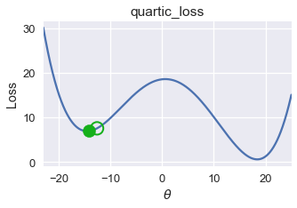
Gradient Descent Only Finds Local Minima
As we saw, the gradient descent procedure can get stuck in a local minimum.
If a function has a special property called “convexity”, then gradient descent is guaranteed to find the global minimum.
Notes:
As we just saw, gradient descent was able to give us the same optimum parameter as scikit learn. in other words it is able to find the global minimum of the mean squared error function.
This raises the interesting question, does gradient descent always give the optimal linear regression parameter. As we saw earlier with our arbitrary function, gradient descent can get stuck in a local minimum.
However, if a function has a special property called convexity, then gradient descent is guaranteed to find the global minimum.

Slide 3
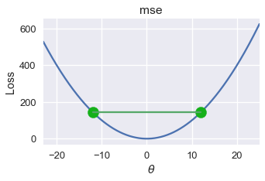
Convexity
Formally, f is convex iff:
Or in plain English: If I draw a line between two points on the curve, all values on the curve must be on or below the line.
E.g. MSE loss is convex:
Notes:
Normally, we say that a function f is convex if and only if it obeys this inequality: T times F of A plus 1 minus T times F of B is greater than or equal to F of T times A plus 1 minus T times B for all a and b in the domain of f, and t in the range between 0 and 1.
This inequality probably seems very mysterious at first. on the homework you'll have a chance to build a deeper mathematical intuition for what this formula means. A simple English translation of this formula is: If I draw a line between two points on the curve, all values on the curve must be on or below the line.
As it so happens, the mean squared error loss function in one dimension is convex. For example, if we draw this line between these points on the mean squared error curve, we see that all of the values on the curve are below the line we drew. And indeed, if we draw any such line between two points on the MSE function, all of the values on the curve between those two points will be below that line.
Though we will not do so here, one can show that for any dataset, the MSE is always convex.

Slide 4
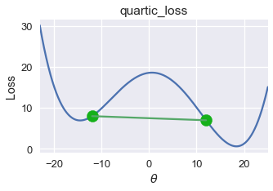
Convexity and Avoidance of Local Minima
For a convex function f, any local minimum is also a global minimum.
If loss function convex, gradient descent will always find the globally optimal parameters.
Our arbitrary curve from before is not convex:
Notes:
Why do we care about convexity?
One reason is that for any convex function f, any local minimum is also a global minimum. That means if the loss function is convex, then gradient descent will always find the globally optimal parameter in one dimension, or set of parameters in higher dimensions.
By contrast, consider our arbitrary function from before with two local minima. Here, I’ve drawn a line segment between two points on the curve such that not every point on the curve is below the line segment. By the definition of convexity, this arbitrary function is not convex. Thus, gradient descent may get stuck in the local minimum to the left.

Slide 5
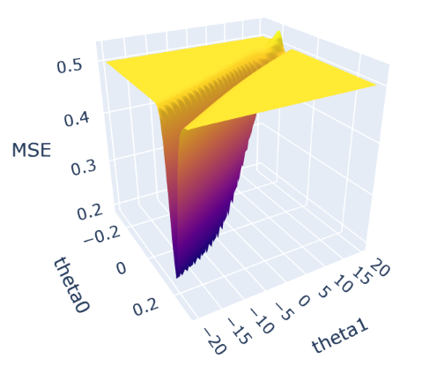
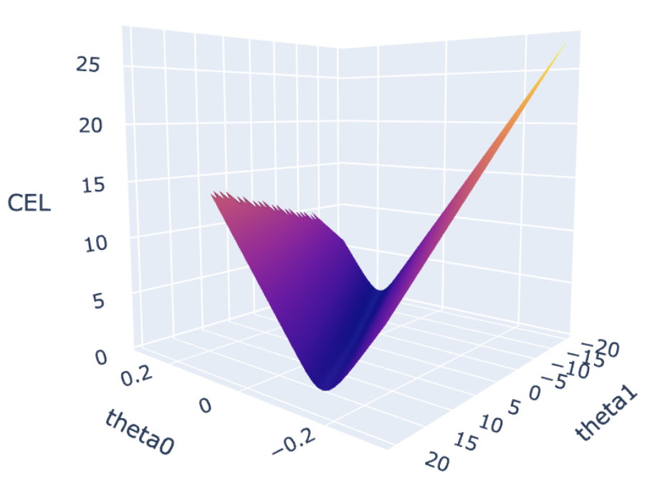
Convexity and Optimization Difficulty
Note to Emeritus slide video editors: If possible it’d be super cool to get a rotating picture of the curve to the right. If that seems at all possible let me know and I can create a video file you can overlay showing that shape spinning. As a flat picture, it’s hard to see.
Notes:
A second reason we care about convexity is that optimization is generally much easier for convex functions. Consider the two 2D functions shown.
The left function is non-convex. The right one is convex.
For the left function, if you are far from the minimum in the large relatively flat region, the slope is too shallow to efficiently follow. Only very near the minimum is the slope steep enough to follow downwards the minimum. By contrast, the convex function has enough “steepness” anywhere so that you can work your way down towards the bottom.
On the homework, you’ll generate and visualize very similar curves.

Slide 6
Video 8: 2D Gradient Descent

Slide 7
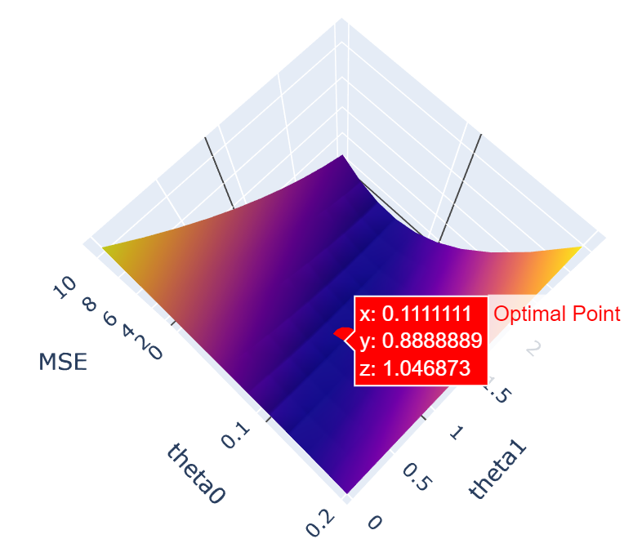
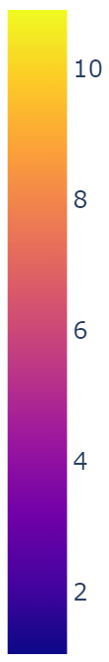
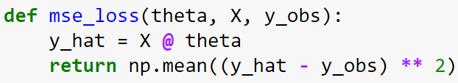
A 2D Loss Function
Here, we see the loss of our model as a convex function of our two parameters.
Notes:
Let’s now turn our attention to convex optimization on multivariable functions. We’ll use this procedure to minimize functions like this 2D loss function for the tips dataset, where the two inputs are the parameters theta0 and theta1.
As we’ll see, multidimensional gradient descent has some important differences from the 1D case.

Slide 8
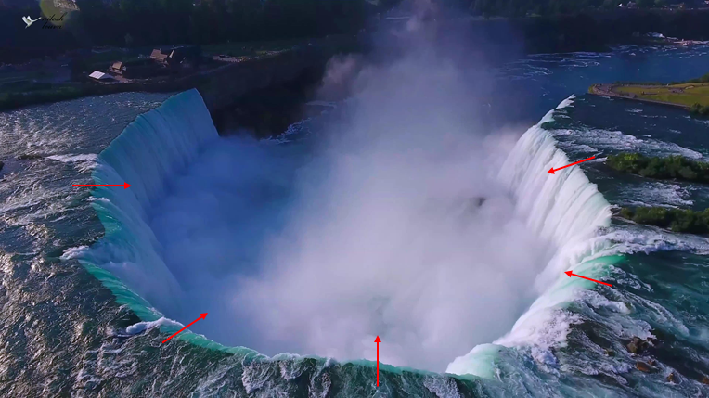
Gradient Descent
Just like earlier, we can follow the slope of our 2D function.
On a 2D surface, the best way to go down is described by a 2D vector.
Notes:
Just like with one dimensional functions, we can optimize a 2D function by following the slope. However, unlike a 1D function, the “slope” of a 2D function is described by a two dimensional vector. In other words, the best way down has two components, each corresponding to the slope with respect to the two input variables to the function.

Slide 9
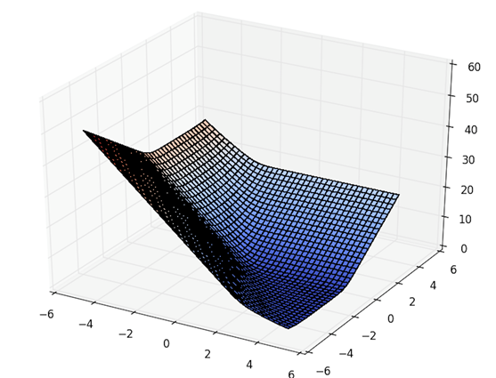
Approach #3: Gradient Descent
On a 2D surface, the best way to go down is described by a 2D vector.
Notes:
Consider the wireframe picture here of a two dimensional function. If the star represents our starting point, the arrow shown gives the “best way down”. If we were doing a gradient descent, the size of the jump we make will be based on the learning rate alpha. We’ll use that alpha along with the two values representing the 2D arrow to reach our next guess for the optimal parameters.

Slide 10
Approach #3: Gradient Descent
On a 2D surface, the best way to go down is described by a 2D vector.
Notes:
After making that jump, we compute the best way down again, yielding the new arrow shown. We again follow the arrow down.

Slide 11
Approach #3: Gradient Descent
On a 2D surface, the best way to go down is described by a 2D vector.
Notes:
We again follow the arrow down, now having made three leaps.

Slide 12
Approach #3: Gradient Descent
On a 2D surface, the best way to go down is described by a 2D vector.
Notes:
After the third leap, we see that the best way down is now starting to curve off from our original direction. Thus, our next leap will take us in this new direction.

Slide 13
Approach #3: Gradient Descent
On a 2D surface, the best way to go down is described by a 2D vector.
Notes:
After our next jump, the best way down has curved off even further. We’ll repeat this process over and over until the function we’re optimizing is no longer decreasing significantly with each step.

Slide 14

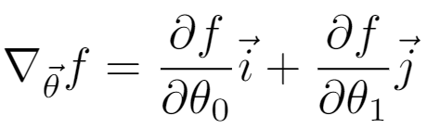



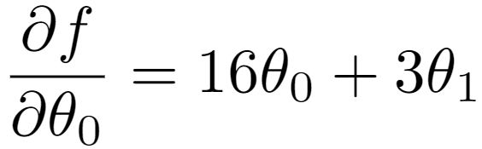
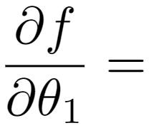
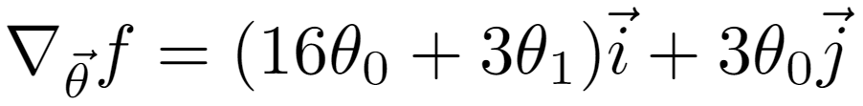

Example: Gradient of a 2D Function
Consider the 2D function:
For a function of 2 variables, we define the gradient , where and are the unit vectors in the θ₁ and θ₂ directions.
Notes:
The formal term for the “best way down” is the “gradient” of the function. The gradient, which you may have studied in a previous class on multivariable calculus, is the generalization of the idea of a derivative of a 1D function. Each component of the gradient represents the partial derivative of the function with respect to one of the input variables to the function. For example, consider the 2D function F, which has input variables theta_0 and theta_1.This function equals 8 times theta_0 squared + 3 times theta_0 times theta_1. Note that this is not a linear regression loss function, as it has a nonlinear dependence on the thetas. This is just some arbitrary function.
Since this function is two dimensional, its gradient has two components, given by the formula shown. The symbol used for the gradient is the nabla, an upside down triangle. This upside triangle symbol is also often pronounced as “del”. For example, here we see that the gradient -- del sub theta of f is equal to the partial derivative of f with respect to theta 0 times the unit vector i plus the partial derivative of f with respect to theta_1 times the unit vector j. Here the unit vector i is the unit vector in the theta_0 direction, and the unit vector j is the unit vector in the theta_1 direction.
Given this definition, we can compute the gradient of our function F.
First, we compute the partial derivative of f with respect to theta_0. This is 16 times theta_0 plus 3 times theta_1.
Then we compute the partial derivative of f with respect to theta_1. This is 3 times theta_0.
Given these two partial derivatives, we can then say that del sub theta of f is the unit vector i times (16 plus theta_0 plus 3 times theta_1) plus the unit vector j times (3 times theta_0).

Slide 15
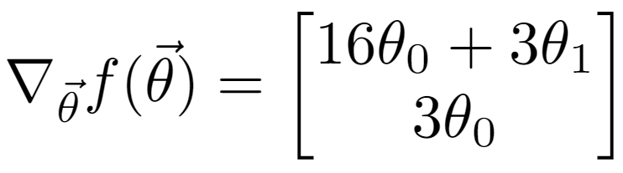
Example: Gradient of a 2D Function in Column Vector Notation
Consider the 2D function:
Gradients are also often written in column vector notation.
Notes:
For notational convenience, gradients are also often written in column vector notation. For example, we can also write the gradient as del sub theta of f of theta is equal to BIG SQUARE BRACES with 16 times theta_0 plus 3 times theta_1 on top, and three times theta_0 on the bottom.

Slide 16
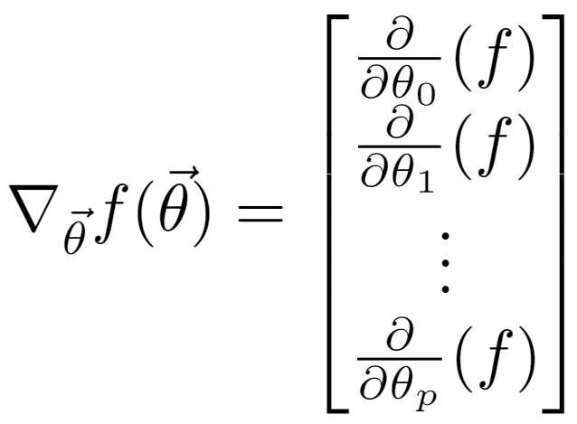
Example: Gradient of a Function in Column Vector Notation
For a generic function of p + 1 variables.
Notes:
We can expand this definition of a gradient to p dimensions. Here, the top value in our column vector is the derivative of f with respect to theta_0, the next value is the derivative of f with respective to theta_1, and so forth, until the last row where we have the derivative of f with respect to theta_p.

Slide 17
How to Interpret Gradients
You should read these gradients as:
If I nudge the 1st model weight, what happens to loss?
If I nudge the 2nd, what happens to loss?
Etc.
Notes:
Let’s now discuss how we can use the gradient of a function to find its optimizing parameters. In the context of model optimization, we can think of the top value in the column vector as follows: If I slightly increase theta_0, what happens to the loss? The next row tells us: If I slightly increase theta_1, what happens to the loss, and so forth.
So if we want to reduce the loss, we should increase all of the thetas that have a negative partial derivative, and decrease all of the thetas that have a positive partial derivative.

Slide 18
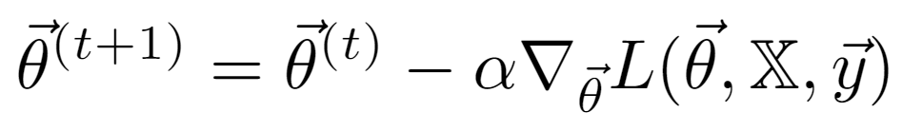
Batch Gradient Descent
Gradient descent algorithm: nudge θ in negative gradient direction until θ converges.
Batch gradient descent update rule:
Next value for θ
Gradient of loss wrt θ
Learning rate
θ: Model weights L: loss function ⍺: Learning rate, usually small constant y: True values from training data
Notes:
This finally brings us to our gradient descent algorithm!
To get the best possible improvement relative to our current guess, we should increase our thetas proportionally to the magnitudes of the partial derivatives, since that is the multidimensional vector that represents the steepest direction of the slope at the current point on the loss surface.
So our gradient descent algorithm will nudge our theta vector in the direction of the negative of the gradient. Just as before, we will repeat this process until eventually theta converges.
Written in mathematical notation, we say that the next guess THETA T PLUS ONE equals THETA T minus alpha times del sub theta of the loss function. Here the gradient is given by del, alpha is the learning rate, THETA T represents the current guess for optimal parameters, and THETA T PLUS ONE represents the next guess for optimal parameters.
Note that the gradient of the loss function depends on our current guess for theta, the input features X, and the true value we’re trying to predict y.

Slide 19
Gradient Descent Algorithm
Initialize model weights to all zero
Also common: initialize using small random numbers
Update model weights using update rule:
Repeat until model weights don’t change (convergence).
At this point, we have θ̂ , our minimizing model weights
Notes:
Note that when we optimize a function using this gradient descent procedure, we have to have some sort of starting guess. This could be all zeros, small random numbers, or some arbitrary starting guess provided as an input to the gradient descent procedure.

Slide 20
Video 9: 2D Gradient Descent for Linear Regression

Slide 21
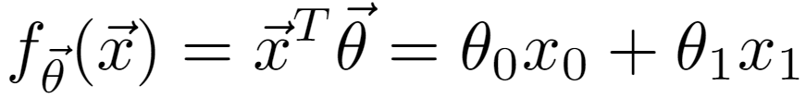
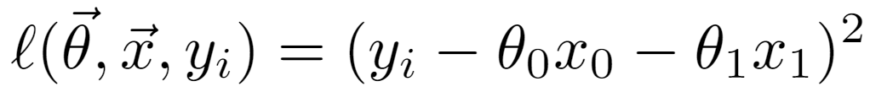
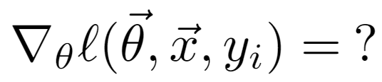
You Try:
Derive the gradient descent rule for a linear model with two model weights and MSE loss.
Below we’ll consider just one observation (i.e. one row of our data).
Squared loss for a single prediction of our linear regression model.
Notes:
Let’s now see how we can write our own gradient descent code from scratch and use it to optimize a 2D linear regression model.
First, we’ll need to compute the gradient of the loss for linear regression.
Here, we have that the output of our model is theta_0 times x_0 plus theta_1 times x_1.
And the loss of our model for a single data point is given by y sub i minus our prediction, squared. Or if we substitute in our prediction, we have the loss of our model equal to y sub i minus theta_0 times x_0 - theta_1 times x_1, all squared. Here, this gives us the loss only for data point number i.
I strongly encourage you to pause the video at this point, and give me the gradient of this loss function for data point number i.

Slide 22
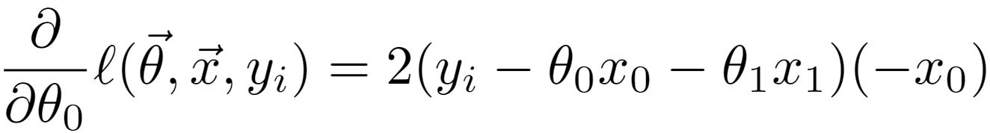

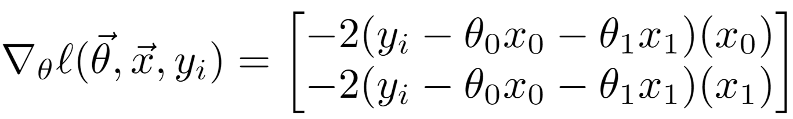
You Try:
Notes:
OK, let me spoil the answer for you now. First, we compute the partial derivative of the loss function with respect to theta_0. This yields 2 times (y sub _i - theta_0 times x0 - theta1 * x1), all times -x0. This -x0 term appears because of the chain rule in Calculus.
Similarly, the partial derivative of the loss function with respect to theta_1 is 2 times (y sub _i - theta_0 times x0 - theta1 * x1), all times -x1. In other words, it’s exactly the same as before only now with -x1 instead of -x0.
Or written as a column vector, we have del sub theta of l equal to the column vector shown, where the top row is the partial derivative with respect to theta_0 and the bottom row is the partial derivative with respect to theta_1.
Now that we’ve derived this expression, let’s put this into code.

Slide 23
Video 10: Screencast of GD Implementation

Slide 25
Video 11: Gradient Descent vs. Stochastic Gradient Descent

Slide 26
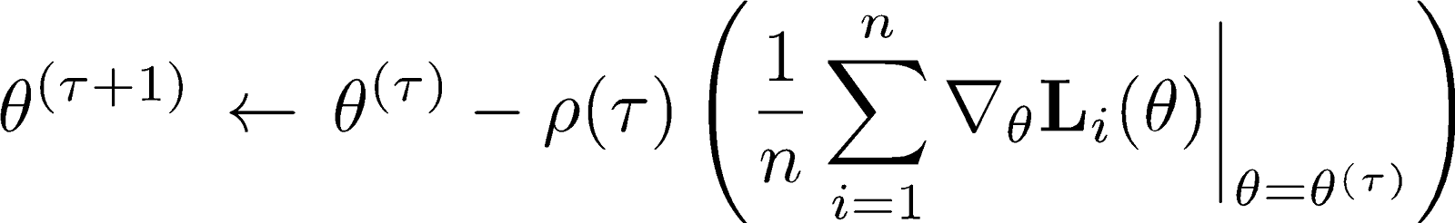
Gradient Descent:
Notes:
Here we see a formula for gradient descent in mathematical notation.
We see that computing the gradient requires iterating over the entire dataset. For our example today, this isn’t such a big deal, since the tip data set is so small. However, for large real world datasets of millions or even perhaps billions of data points, recomputing a gradient can be extremely costly.

Slide 27
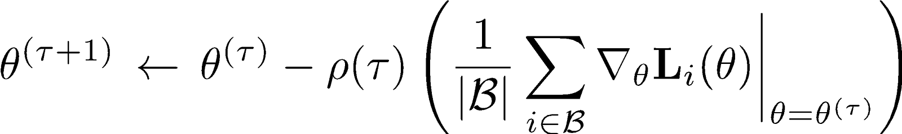
Gradient Descent:
Stochastic Gradient Descent:
Notes:
In the approach that we just saw, we instead compute the gradient for a batch of data, where the batch is smaller than the entire dataset. In the case where the batch size is 1, we have stochastic gradient descent, where the optimizing algorithm is only considering a single datapoint at a time.
It should surprise and perhaps shock you that this works. Imagine that we’re trying to train an algorithm to recognize pictures of dogs. Stochastic gradient descent adjusts what might be an absolutely massive number of model parameters based on only a single training image at a time. The analogy might be something like trying to win a game of Chess while only looking at a few squares of the board at once.
And yet it works! How this happens is beyond the scope of the class, but the rough idea is that if we iterate over the dataset multiple times, then on average, we’ll end up in roughly the same place as if we’d been computing the true gradient based on the entire dataset.
In effect, our batch size is a parameter that gives us the ability to tradeoff the quality of our gradient approximation against the runtime to compute our gradient approximation. If the batch size is 1, the quality is minimum, but the calculation is very fast. If the batch size is the same as the data, the quality of the gradient is extremely good, but the calculation is very slow. There have been many rules of thumb developed. For example, for reasons far beyond the scope of our course, 32 is a common choice of batch size.

Slide 28
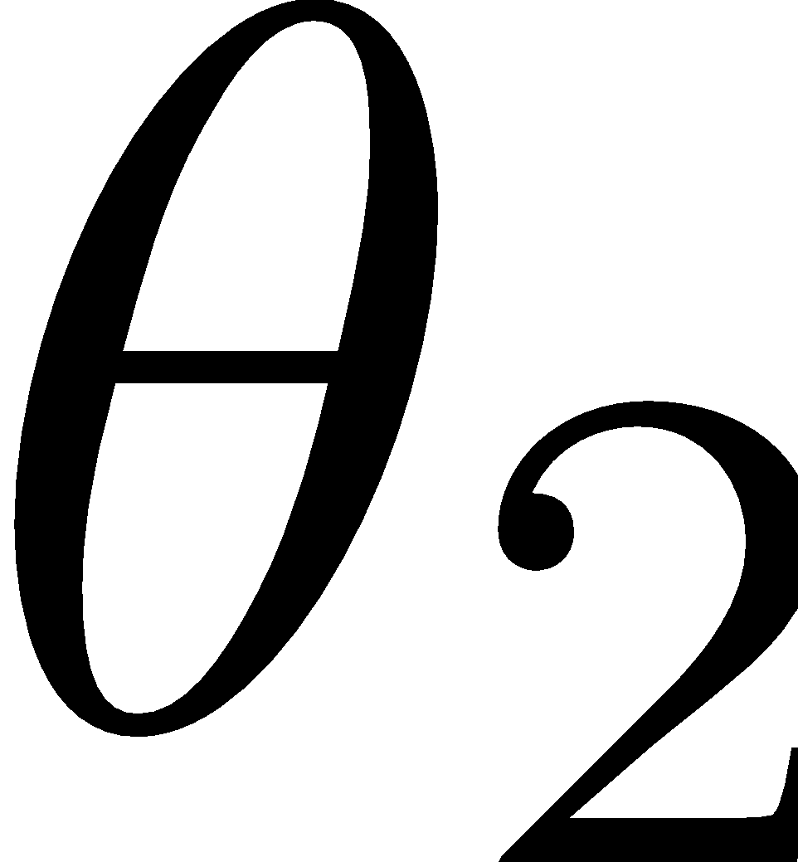

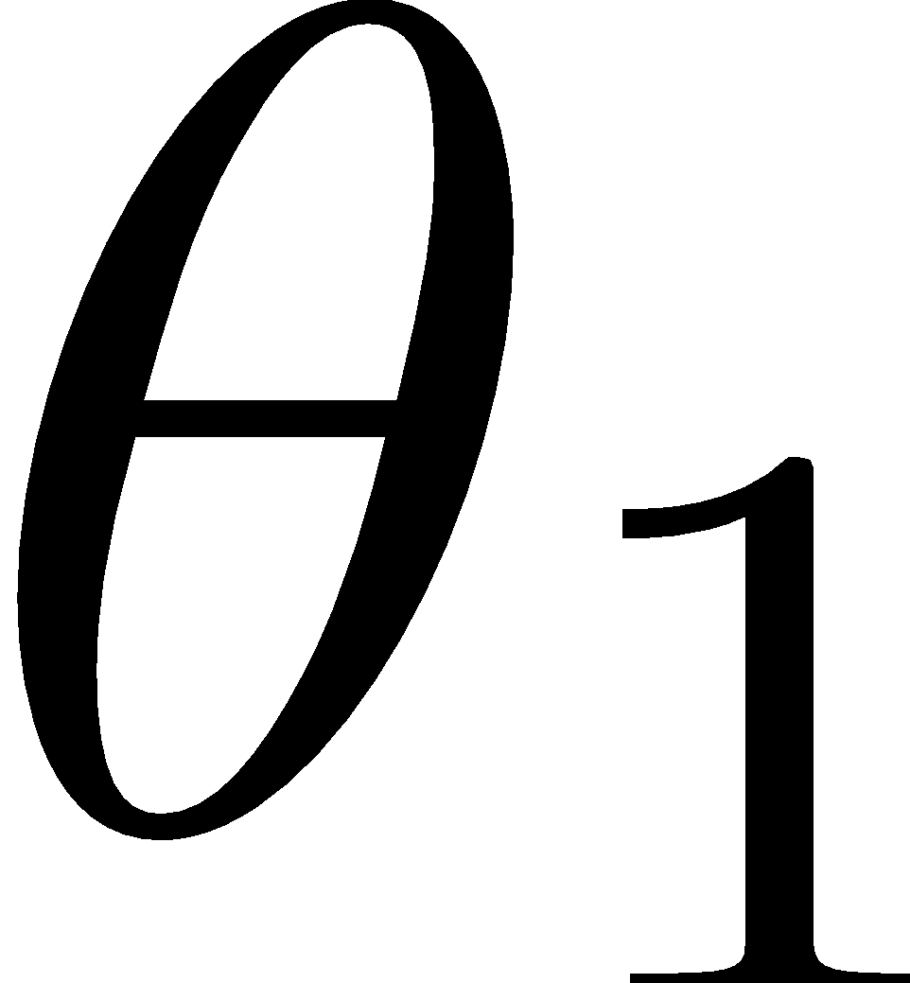
Notes:
Let’s see that idea from another perspective. Here we see a visual picture of gradient descent where our batch size is the size of the dataset. Here, the darker the color, the lower the loss. We see that if we start at the origin, gradient descent follows the true steepest path towards the minimum.

Slide 29
Notes:
Now we see a visual picture of gradient descent where our batch size is small. As before, the darker the color, the lower the loss.
This time, since we’re only considering a small subset of the data, we only get a crude approximation of the gradient. For example, the first jump is not in the direction of the steepest drop towards the minimum, but it still results in some progress relative to where we started.
We repeat this process again and again, moving in a more random fashion across the true loss surface. After all, at each jump, we’re only moving based on a crude approximation of the true loss surface. Eventually, for convex functions like MSE, we’ll end up converging somewhere close to the true minimum.

Slide 30
Gradient Descent vs. Mini-batch
Gradient descent: Used by sklearn.
Mini-batch gradient descent: Very common when dealing with huge amounts of data.
Notes:
In practice, both techniques are used. For example, for all the sklearn models we’ve talked about in our class, gradient descent on the full dataset is utilized.
However, in environments with large amounts of data, it is much more common to use mini-batch gradient descent, because the cost of computing the gradient on the entire dataset is too high, resulting in very slow algorithm training times.
Zooming out a bit: In practice, you’ll almost never write your own gradient descent algorithms. And for the most part, you’ll be using function optimization libraries without having any need to know how they work. Indeed, until today, we’ve just treated out function optimization libraries like magic! In the same way that you can drive a car without understanding how an engineer works, you can train and even use machine learning models without ever learning about gradient descent, since in some ways, it’s a low level detail that is handled for you by somebody else’s code.
However, in my opinion, having at least some knowledge of how gradient descent works is important for serious ML practitioners, even if you don’t interact with gradient descent itself directly.

Slide 31
Video 12: Implicit Regularization and Stochastic Gradient Descent

Slide 32
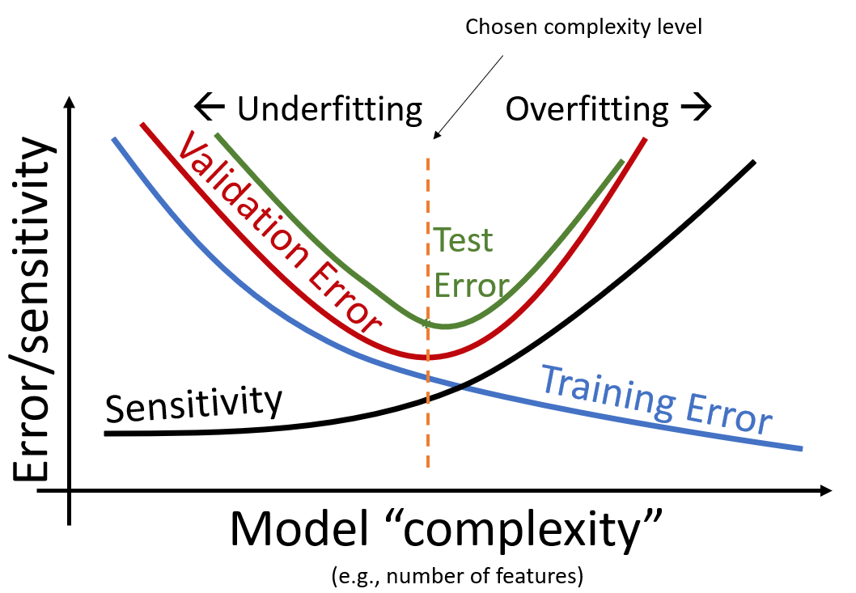
Error vs. Complexity
Notes:
Recall that the classical picture of machine learning models is that as model complexity goes up, the training error will tend to decrease more and more. By contrast, the test error will go down for a while, then back up as the model begins to overfit.

Slide 33
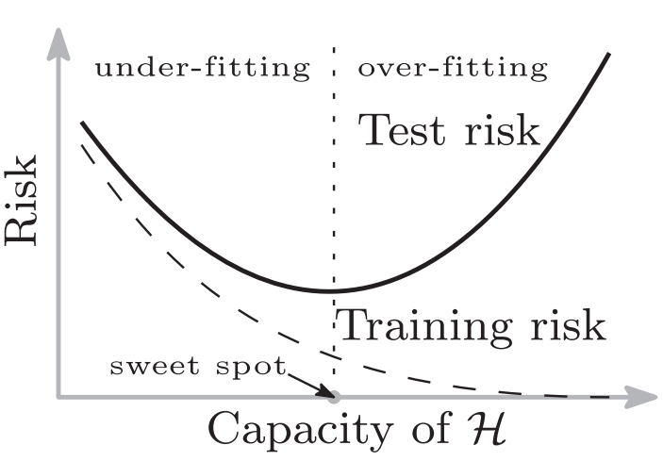
Risk vs. Capacity
Notes:
Here is the same picture again, from a paper called “Reconciling modern machine-learning practice and the classical bias–variance trade-off” from 2019 by Belkin. Here, the error is called “risk”, and the complexity is called the “capacity”. These terms have a slightly different technical meaning, but this is beyond the scope of our course.

Slide 34
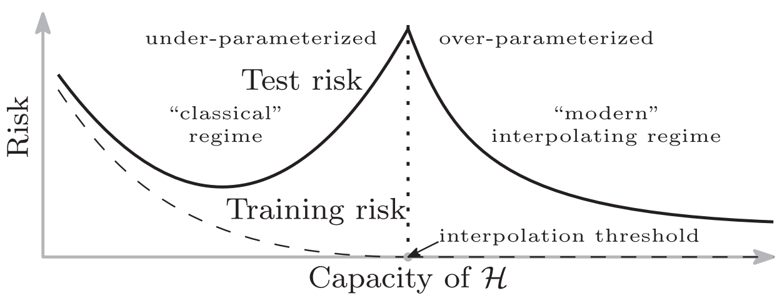
Double Descent
Notes:
In the late 2010s, it was observed that some models exhibited a surprising relationship between test error and model complexity.
This figure, also taken from “Reconciling modern machine-learning practice and the classical bias–variance trade-off” from 2019 by Belkin et. al, shows a common pattern that was observed when training large neural networks. Right around the level of complexity that results in zero training error, the test error spikes… but if we push the model to even higher levels of complexity, the test error starts to decrease again. And in many real world cases, the test error actually ends up reaching an even lower value than the “sweet spot” we discussed in earlier lectures.
In other words, in the world of practical machine learning, an entirely new regime was discovered for large models, which this paper calls the “modern interpolating regime”. They use the word “interpolating” to represent situations where the training set has zero error.

Slide 35
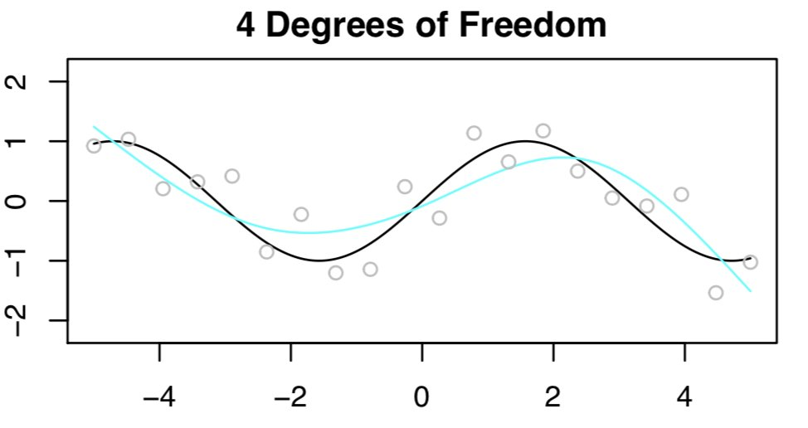
Double Descent in Linear Regression
Notes:
Other papers from the same time period showed this phenomenon also existed in many other simple machine learning model contexts, even including linear regression!
These figures, taken from a series of Tweets by Dr. Daniela Witten in August 2020, portray the situation quite nicely.
First we see a degree 4 linear regression model fit to 20 data points. Note that here Dr. Witten is using something called “spline regression”, which is similar to but not the same thing as polynomial regression.
Here the data points are in gray, the blue line is the model fit, and the black line is the real process which generated the data (which also had some noise added in).

Slide 36
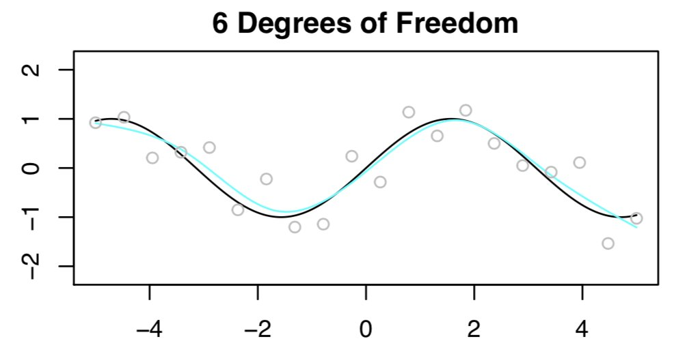
Double Descent in Linear Regression
Notes:
When we move to a degree 6 model, we see that we’re doing even better!

Slide 37
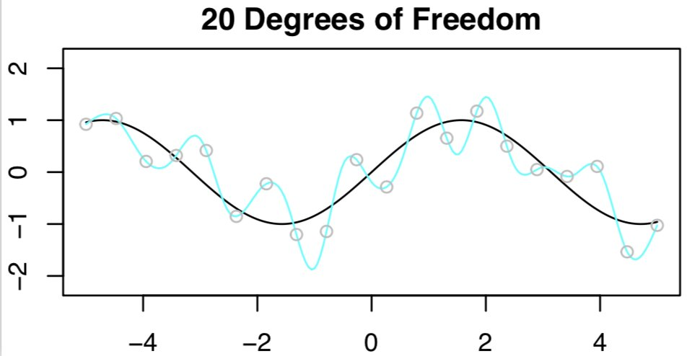
Double Descent in Linear Regression
Notes:
If we now move to a degree 20 model, we see that while we have zero training error, our model is grossly overfit. This is very similar to what we observed in our class. The model is interpolating the observed training data perfectly, but for points adjacent to the training data, the model is failing to capture the true data generation process. It’s a mess! We’ve clearly overshot the sweet spot.

Slide 38
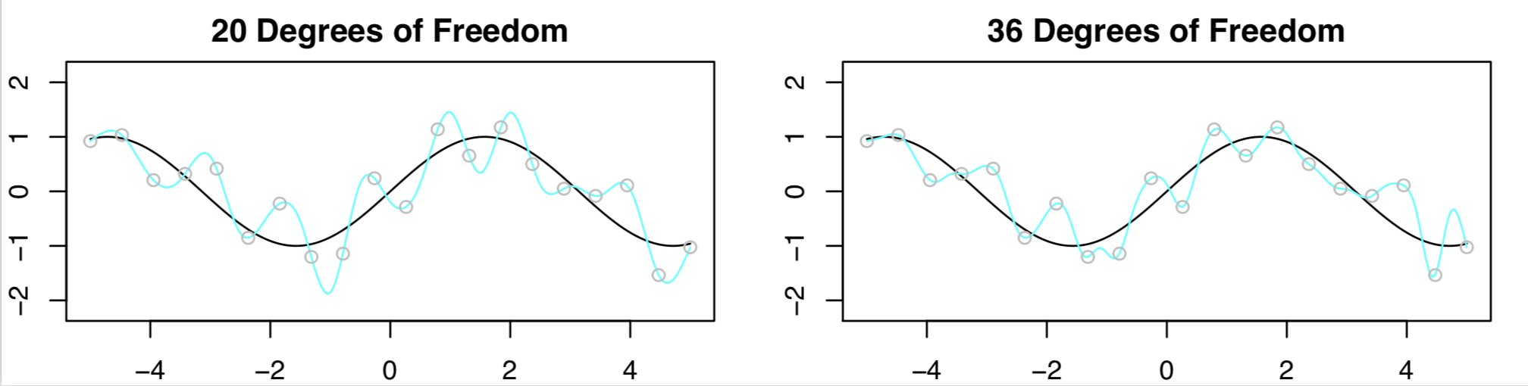
Double Descent in Linear Regression
Notes:
Now here is where it gets weird. What if we have even more than 20 parameters. For example, imagine fitting a degree 36 polynomial to 20 data points. If you think about it, we basically have 36 linear equations and 20 unknowns. There are an infinite number of possible solutions that all yield zero training error.
This figure, also by Dr. Witten, shows the side by side results for a 20 parameter and a 36 parameter model.
The 36 degree model is slightly better! By moving deeper into the modern interpolating regime, we’ve now observed double descent, where the test error actually drops again.

Slide 39
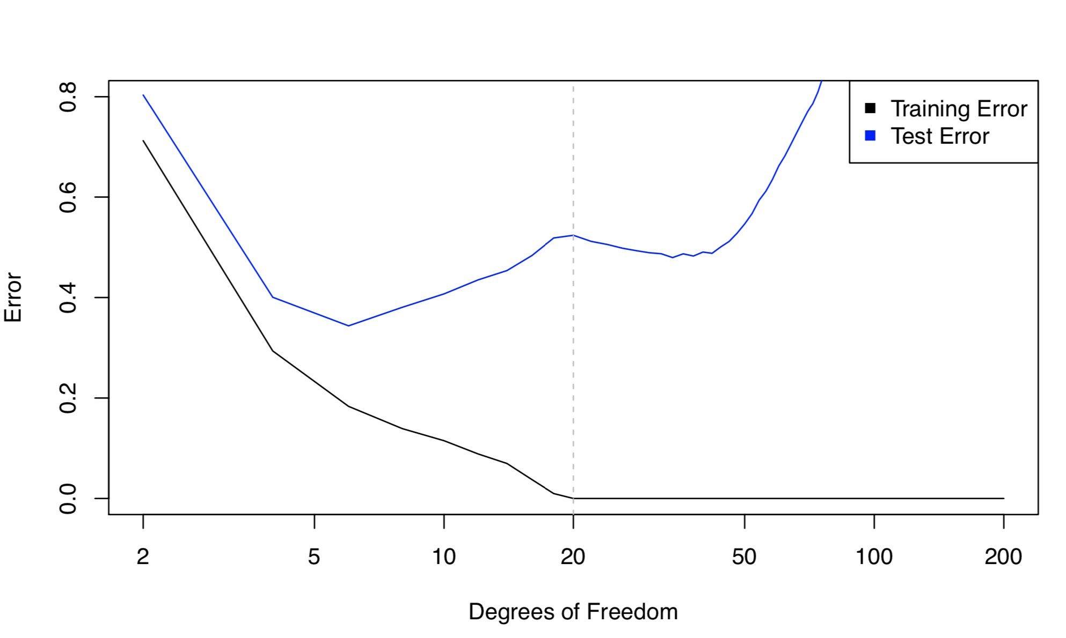
Training and Test Error
Notes:
Or if we plot Dr. Witten’s Training and Test Error vs. Complexity for this example, we get the figure shown. Note that the test error in this case spikes back up for more degrees of freedom. In other contexts, like neural networks, this spike back up does not occur.
Also note that the test error after the second descent does not reach a new lower value. However, in some contexts, like those shown in the cartoon earlier from Belkin’s paper, the test error is actually lower after the double descent.
So what.. you may ask, does this have to do with stochastic gradient descent? It turns out that understanding SGD also gives some insight into why this double descent occurs!

Slide 40
Notes:
Let’s rewind a bit! As Dr. Witten notes, there are an infinite number of models which are overparameterized and have zero training error. As we showed earlier in our class, if we have N data points, and a model with N parameters, then there exists exactly one set of parameters that fit the data perfectly.
But if we increase the number of parameters even higher, we end up with a situation where the model is overparameterized, and there are an infinite number of valid choices of parameter that yield zero training error.
How do we know which model we’ll end up with from amongst this infinite set of possibilities?
That’s where knowledge of stochastic gradient descent becomes useful. Stochastic gradient descent is a specific procedure, so we can experimentally explore where it’ll land among the infinite possible models with zero training error. For reasons beyond the scope of our class, it turns out that stochastic gradient descent yields a solution which is implicitly regularized. In other words, even without an explicit regularization term, overparameterized models that are trained with stochastic gradient descent act like they are regularized, and as the number of parameters in a model grows, the impact of this effect increases. The net result is what we saw in Dr. Witten’s post, where extremely high order models are actually less wiggly. Or more plainly stated, stochastic gradient descent results in a model which is implicit regularized, yielding less wiggly behavior. Counterintuitively, because the 36 degree model has a greater implicit regularization strength, it is actually less “free” than the 20 degree model.
For a deeper treatment of this idea, see the 2021 paper “‘Implicit Gradient Regularization” by David Barrett.
I should note that at the time of this video, the double descent phenomenon (and related topics) are still a topic of very active research, and a full treatment is beyond the scope of our class. I am presenting this to you today to give you a flavor of the ideas, but do not expect you to deeply understand these cutting edge ideas and the underlying theory that I do not myself fully understand yet.

Slide 41
Video 13: The Bias Variance Tradeoff

Slide 42
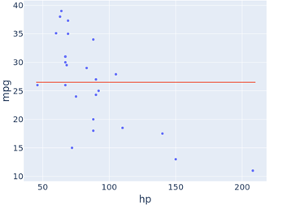
High Bias: Degree 0 Model
Notes:
Before we wrap up today, let’s briefly discuss an important concept known as the bias variance tradeoff.
We can think of the error of a model as stemming from two sources: The Bias, and the Variance.
The bias represents the fundamental inability of a model to fit the data, no matter what parameters are provided.
For example, consider the MPG dataset shown. Suppose we fit a model which only has an intercept term, i.e. it believes that all vehicles have the same fuel efficiency. Such a model will be unable to capture the dependency that we see visually on the plot. The bias here is high. One way to remember this is to think “The model has a preconceived notion or bias that all vehicles have the same fuel efficiency”

Slide 43
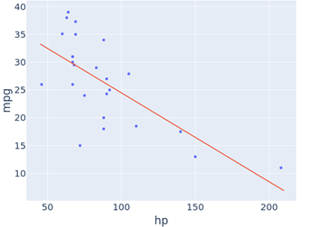
Lower Bias: Degree 1 Model
Notes:
If we fit a model with an intercept and a slope, then we have a model like the one shown. Here the bias is lower than before.

Slide 44
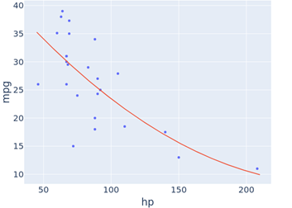
Even Lower Bias: Degree 2 Model
Notes:
If we then fit a degree two polynomial, then we have a model what is able to capture the roughly parabolic shape observed in the data. The bias is even lower.
If we were to fit a degree 25 polynomial (not shown), since we have only 25 data points, our bias will go to zero. Our model would be able to perfectly fit the training data.

Slide 45
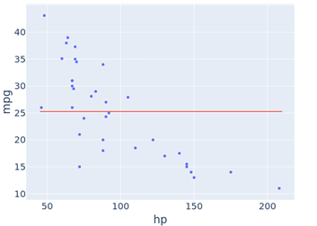
Low Variance: Degree 0 Model
Notes:
A very high degree model has low or even zero bias. But, it has a serious problem: Variance.
We’ve mentioned variance before. Variance, roughly speaking, represents how sensitive the model is to the data.
This model, with only an intercept term, has low variance. Small changes to the data result in only small changes to the model.

Slide 46
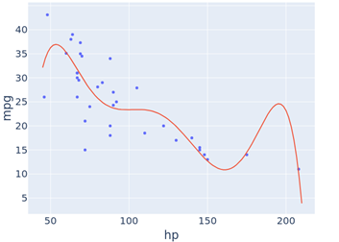
High Variance: Degree 6 Model
Notes:
By contrast a higher order model, like the degree 6 model shown, has a high variance. Even a small change to a single data point can result in a dramatically different model.

Slide 47
Training and Test Error
Notes:
Why am I bringing this up?
It’s because bias and Variance can be given formal mathematical definitions, though we will not do so here. After formally defining them, we can show that the expected loss (also known as the risk) is equal to the square of the bias plus the variance plus another term I won’t describe.
Now, as our model complexity increases, the bias will decrease, and the variance will tend to increase.

Slide 48
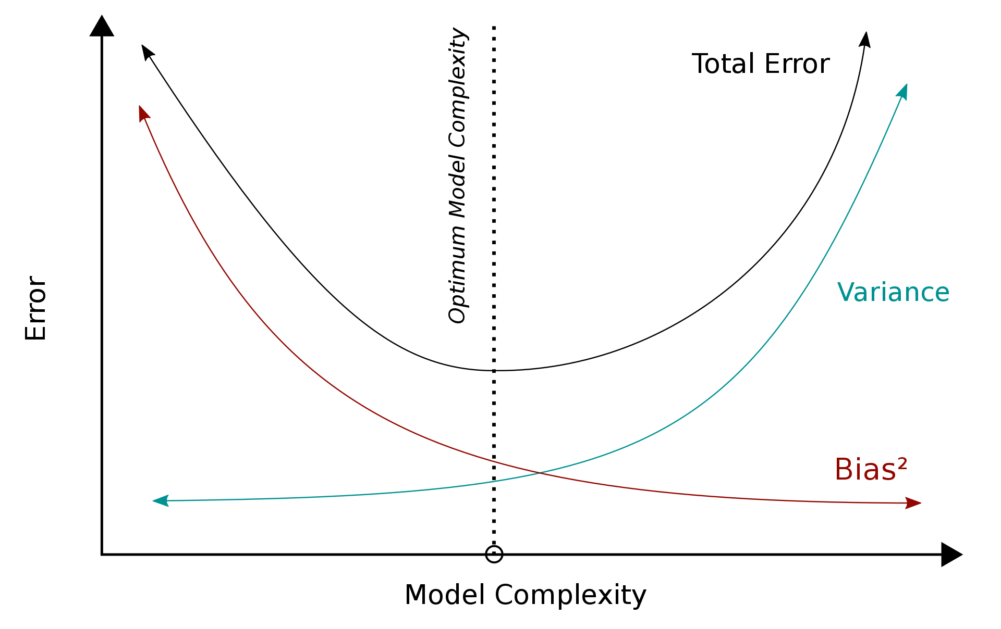
Training and Test Error
Notes:
Visually, we see here the error, bias squared, and variance of a model vs. the complexity in the classical regime.
In this regime, our ideal model will sit at the sweet where bias has gotten fairly low, but variance has not yet taken off.

Slide 49
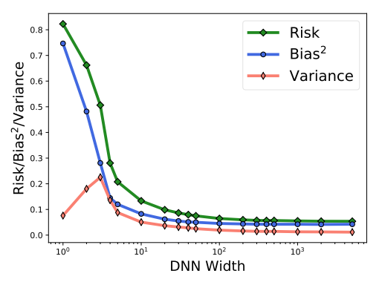
Notes:
By contrast, in the modern interpolating regime, the variance often increases, but then begins to decrease as we go deeper into the interpolating regime, for reasons we alluded to earlier when discussing stochastic gradient descent.
This figure comes from “Rethinking Bias-Variance Trade-off for Generalization of Neural Networks” from 2020 by Zitong Yang et. al. In this paper, the authors experimentally compute the bias squared, variance, and expected loss for a model as a function of the model’s complexity.
The classical picture of the bias-variance tradeoff is shown at the leftmost part of this figure. Bias is decreasing, but variance is increasing. The sweet spot representing the optimal model was classically assumed to occur in this space.
However, for this specific experiment, as we move into the interpolating regime, the variance begins to drop again, eventually reaching lower levels than for simpler models. At the same time, the bias continues to decrease as well. As a result, the optimal model is actually way out towards the right hand side of the figure. In this case, there is no bias-variance tradeoff. Instead, we build a model as big as possible, as such a model minimizes BOTH bias and variance.
And in common practice today, many of the world’s most advanced models are absolutely gigantic neural networks with hundreds of billions of parameters or more. For such models, the number of parameters far exceeds the number of data points. And part of the reason this all happens is the way that stochastic gradient descent chooses from among the infinite number of models with zero (or very low) training error.
Note that we’ll discuss neural networks in a later module.

Slide 50
Video 14: Summary

Slide 51
Summary
Gradient descent allows us to find the minima of functions.
At each step, we compute the steepest direction of the function we’re minimizing, yielding a p-dimensional vector.
Our next guess for the optimal solution is our current solution minus this p-dimensional vector times a learning rate alpha.
For convex functions, the minimum that gradient descent finds is guaranteed to be a global minimum.
Optimization procedures on convex functions tend to converge much more quickly than on non-convex functions (even those with a single minima).
Stochastic gradient descent lets us to rapidly compute an approximation of the gradient.
Can be done in batches of data, or even on a single data point.
Notes:
Gradient descent allows us to find the minima of functions.
At each step, we compute the steepest direction of the function we’re minimizing, yielding a p-dimensional vector.
Our next guess for the optimal solution is our current solution minus this p-dimensional vector times a learning rate alpha.
For convex functions, the minimum that gradient descent finds is guaranteed to be a global minimum.
Optimization procedures on convex functions tend to converge much more quickly than on non-convex functions (even those with a single minima).
Stochastic gradient descent lets us to rapidly compute an approximation of the gradient.
Can be done in batches of data, or even on a single data point.

Slide 52
Bias-Variance Tradeoff and Double escent
In classical machine learning, we choose a model complexity that minimizes the bias-variance tradeoff.
In some modern machine learning settings, we pick the largest possible model, as that minimizes both bias and variance.
Empirically, we sometimes observe a double descent behavior, where as the number of parameters grows, we first see the test error decrease, before eventually increasing again.
Understanding stochastic gradient descent provides insight into why this counter-intuitive phenomenon occurs.
Notes:
In classical machine learning, we choose a model complexity that minimizes the bias-variance tradeoff.
In some modern machine learning settings, we pick the largest possible model, as that minimizes both bias and variance.
Empirically, we sometimes observe a double descent behavior, where as the number of parameters grows, we first see the test error decrease, before eventually increasing again.
Understanding stochastic gradient descent provides insight into why this counter-intuitive phenomenon occurs.

